Slide 1

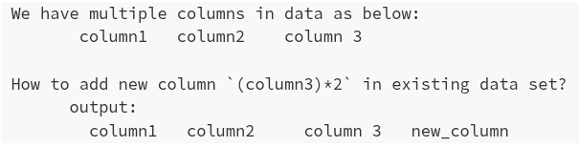

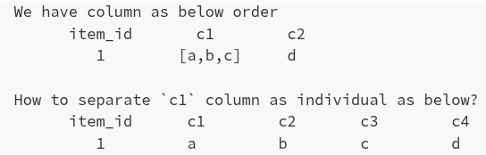
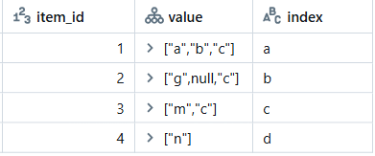
PySpark Interview Question: 30
Question 01
Question 02
How to Split Array values into separate columns?
Question 03

